Slide 1

FINRA Compliance Evaluation System
AI-Powered Architecture for Financial Text Analysis
Automated Risk Detection & Regulatory Compliance Monitoring

Slide 2

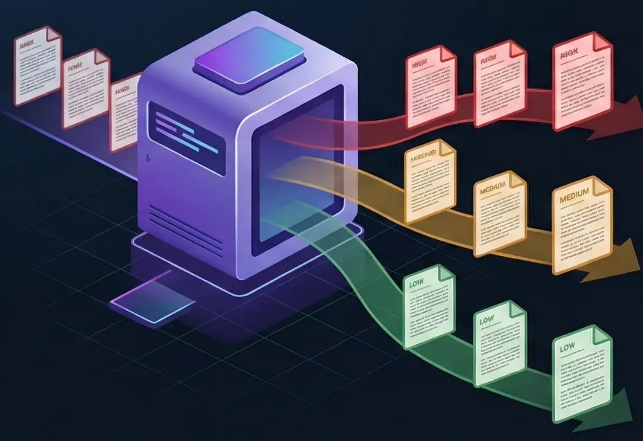
START: Synthetic Data Generator
Foundation Layer of the Compliance System
The system initiates with a generator creating nine financial texts labeled as high, medium, and low risk ground truth
• Generates 9 distinct financial text samples
Risk Distribution
• Each text pre-labeled with known risk level
• 3 HIGH RISK texts • 3 MEDIUM RISK texts • 3 LOW RISK texts
• Creates ground truth dataset for evaluation
• Ensures balanced representation across risk categories

Slide 3




Three Parallel Input Streams
Risk-Categorized Financial Text Analysis
HIGH RISK TEXT
MEDIUM RISK TEXT
LOW RISK TEXT
Guaranteed returns and misleading claims
Vague performance implications
Compliant disclosures
Example
Example
Example
Promises of specific returns, Exaggerated performance claims, Omitted risk disclosures
Unclear return expectations, Ambiguous risk statements, Partial compliance language
Clear risk warnings, Appropriate disclaimers, Regulatory compliance language

Slide 4

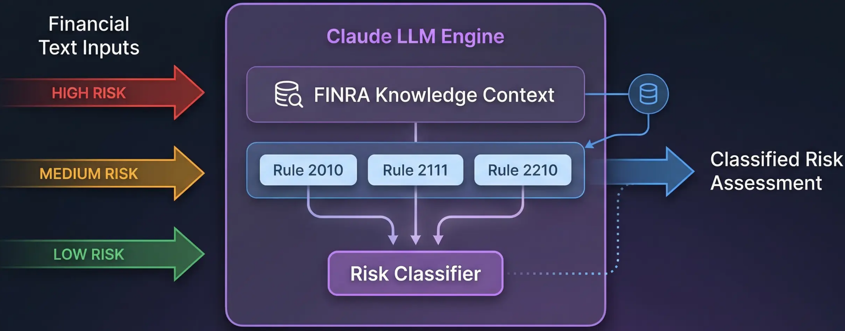
CLAUDE LLM ENGINE and FINRA Context
Regulatory Knowledge Integration & Risk Classification

Slide 5

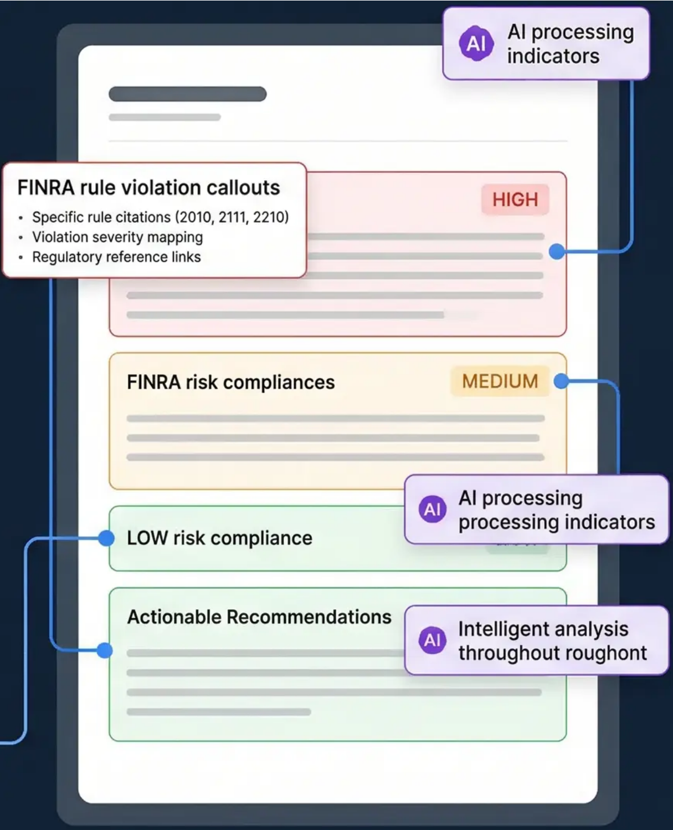
COMPLIANCE REPORT Output
Comprehensive AI-Generated Analysis Results
Risk Level Assessment
FINRA Violations Found
• HIGH / MEDIUM / LOW classification • Confidence score percentage • Risk probability indicators
• Specific rule citations (2010, 2111, 2210) • Violation severity mapping • Regulatory reference links
Flagged Phrases
Actionable Recommendations
• Problematic language identification • Context-aware phrase analysis • Suggestion alternatives provided
• Immediate compliance steps • Risk mitigation strategies • Preventive measures guidance
Intelligent Analysis
Claude LLM processes each financial text through FINRA regulatory knowledge to deliver precise, actionable compliance insights with full traceability.

Slide 6

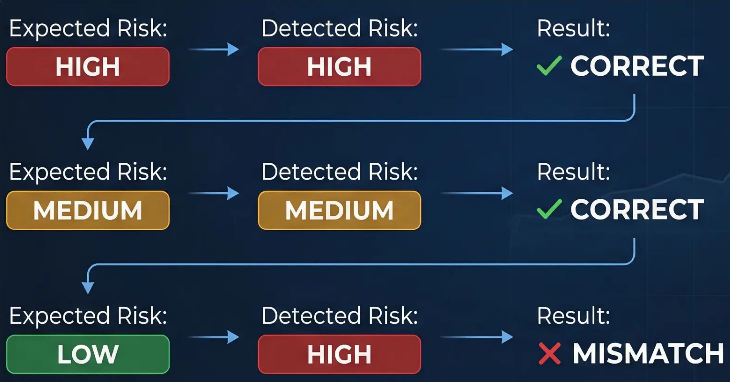
EVALUATION LAYER Comparison
Performance Validation & Accuracy Measurement
Comparison Process
77.8%
System Accuracy
Correct Matches: 7/9
Mismatches: 2/9
Precision Rate: Strong

Slide 7

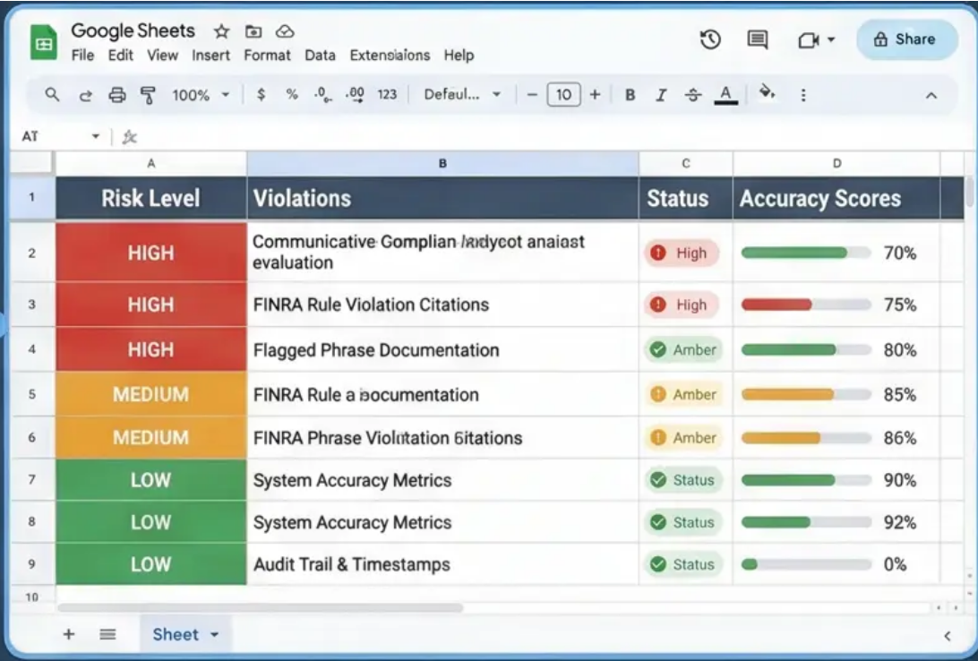
FINAL OUTPUT: Google Sheets Compliance Report
Structured Compliance Evaluation & Performance Analytics
The system concludes by exporting the finalized compliance evaluation and accuracy metrics into a comprehensive, structured Google Sheets report for stakeholder review and regulatory documentation.
Key Features Callout Box
• Automated Report Generation
• Flagged Phrase Documentation
• Risk Level Classifications
• System Accuracy Metrics
• FINRA Rule Violation Citations
• Audit Trail & Timestamps

